Slide 1
www.zeitfuerdeutsch.com

Slide 2
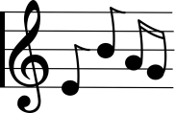
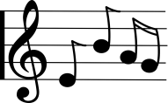
Silent Night – Stille Nacht
LO: Sing ‘Silent Night’ in German
SC
I can sing the first verse of ‘Stille Nacht’
I know the German for ‘everything’, ‘alone’, ‘only’ and ‘a pair’
I can work in a team to re-create ‘Stille Nacht’ using cards
I can sing ‘Stille Nacht’ in a round in my class

Slide 3
Das Kartenspiel
Yes, correct
No, incorrect
Good
Super
Excellent
Fantastic
Brilliant
Wonderful
Great
Tremendous/super/great
Beautiful/great
Ja, Richtig
Nein, Falsch
Gut
Super
Ausgezeichnet
Fantastisch
Brilliant
Wunderbar
Großartig
Prima
Schön

Slide 4
Silent Night – Stille Nacht
Silent Night
Holy Night
All is sleeping
Alone watches
Stille Nacht
Heilige Nacht
Alles schläft
Einsam wacht

Slide 5
Silent Night – Stille Nacht
Only the close,
Most holy couple
Blessed boy
In curly hair
Sleep in heavenly peace
Sleep in heavenly peace
Nur das traute
Hochheilige Paar
Holder Knabe
Im lockigen Haar
Schlaf in himmlisher Ruh
Schlaf in himmlisher Ruh

Slide 6
Vocabulary
Everything/all
Alone/lonely
Only
A pair/couple
Alles
Einsam
Nur
Ein Paar

Slide 7
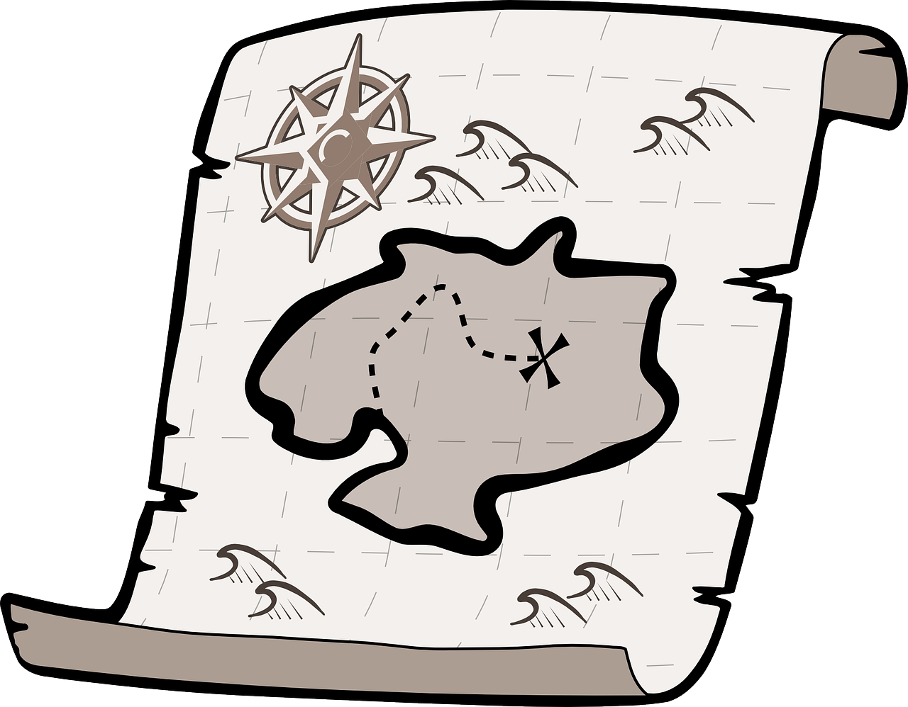
Scavenger Hunt

Slide 8
?
Who is singing?

Slide 9
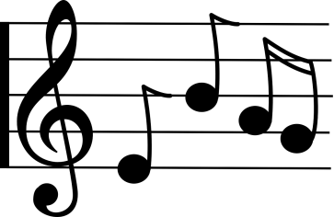
Round of ‘Stille Nacht’
Stille Nacht
Heilige Nacht
Alles schläft
Einsam wacht
Nur das traute
Hochheilige Paar
Holder Knabe
Im lockigen Haar
Schlaf in himmlisher Ruh
Schlaf in himmlisher Ruh

Slide 10
Silent Night – Stille Nacht
LO: Sing ‘Silent Night’ in German
SC
I can sing the first verse of ‘Stille Nacht’
I know the German for ‘everything’, ‘alone’, ‘only’ and ‘a pair’
I can work in a team to re-create ‘Stille Nacht’ using cards
I can sing ‘Stille Nacht’ in a round in my class

