Slide 1
www.zeitfuerdeutsch.com

Slide 2
Parts of the Body
LO: Name the parts of the body in German
SC
I can play das Kartenspiel and give ‘Lob’ to support my partner
I can listen to a word and point to the correct part of the body
I can play ‘Simon says’ in German
I can sing ‘Heads shoulders, knees and toes’ in German

Slide 3
The Flashcard Game
Yes, correct
No, incorrect
Good
Super
Excellent
Fantastic
Brilliant
Wonderful
Great
Ja, Richtig
Nein, Falsch
Gut
Super
Ausgezeichnet
Fantastisch
Brilliant
Wunderbar
Großartig

Slide 4
What is that?
That is ...
Was ist das?
Das ist ...

Slide 5
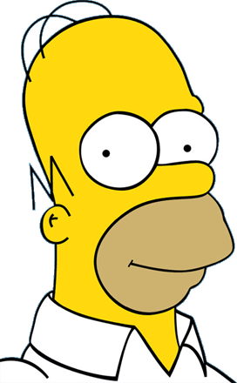
der Kopf

Slide 6
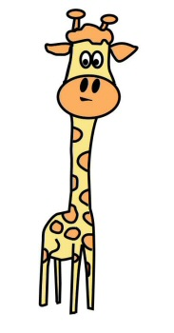
der Hals

Slide 7
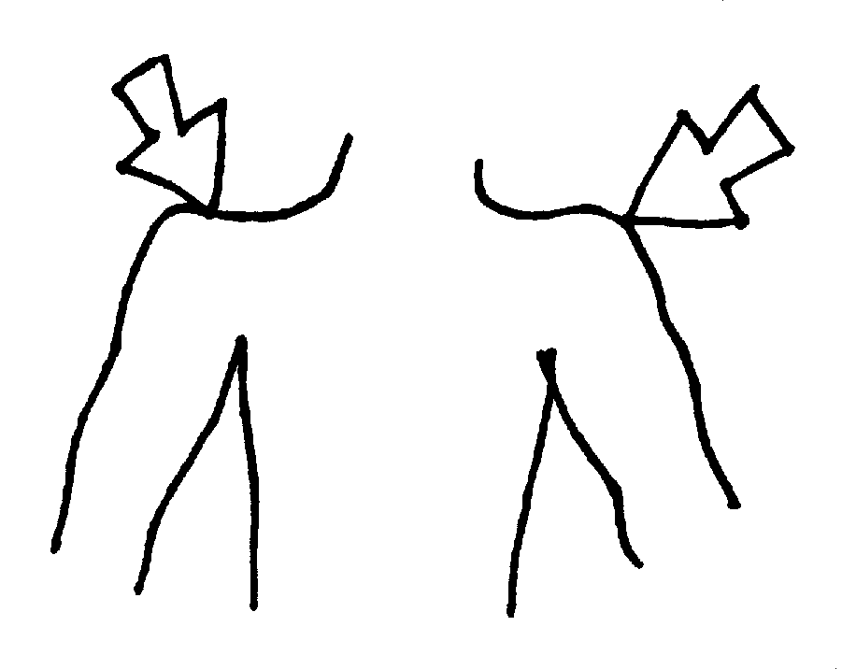
die Schulter

Slide 8
der Arm

Slide 9
der Ellbogen

Slide 10
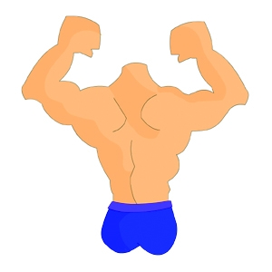
der Rücken

Slide 11
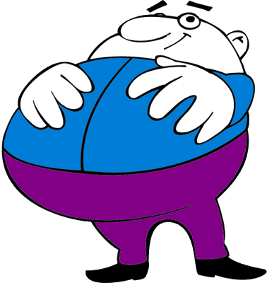
der Bauch

Slide 12
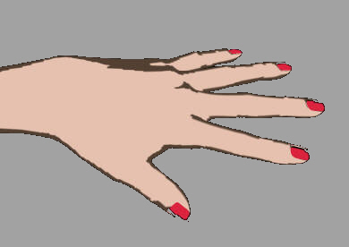
die Hand

Slide 13
der Finger

Slide 14
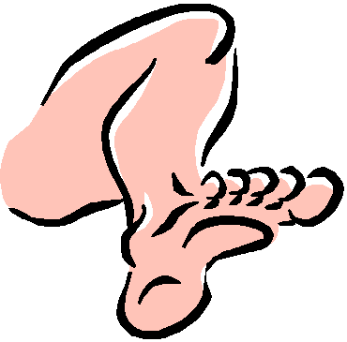
das Bein

Slide 15
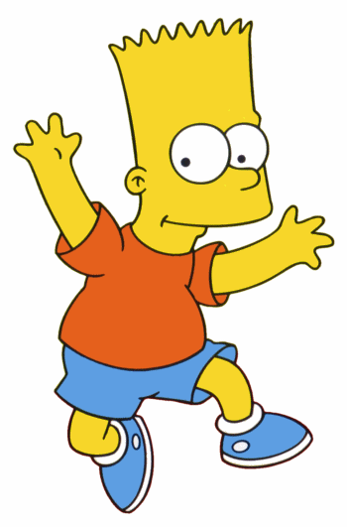
das Knie

Slide 16
der Fuß

Slide 17
der Zeh

Slide 18
The Face – Das Gesicht
The eyes
The ears
The nose
The mouth
The chin
Die Augen
Die Ohren
Die Nase
Der Mund
Das Kinn

Slide 19
Hans sagt
behrüht der/die/das …………………

Slide 21
Zusammen - Together
Work with a partner using a wipe board and pen
Teacher says something we have learnt over the last 2 weeks in English
You work together quietly to write the German on your wipe board
After the time limit, reveal your answer
Repeat for different sentences

Slide 22
Parts of the Body
LO: Name the parts of the body in German
SC
I can play das Kartenspiel and give ‘Lob’ to support my partner
I can listen to a word and point to the correct part of the body
I can play ‘Simon says’ in German
I can sing ‘Heads shoulders, knees and toes’ in German

